Slide 1
Submission to IEEE VIS 2021

Slide 2


Review of previous submission
Evaluation:
Comparisons to related approaches (baseline)
Effect of different hyperparameters
Computational burden
Quantitative measures
Real-world use case
Demonstration of projection fidelity
Writing:
More algorithmic details and clearer statement of technical contribution

Slide 3
Paper Structure
Introduction
Related Work
comparable projections
Measuring the Similarity between Graphs
t-Distributed Stochastic Neighbor Embedding
Joint t-SNE
Computing Graphlet Frequency Distribution (remove layers) + Accelerating Joint t-SNE using a Random Walk
Computing Point and Edge Similarities (but no point constraint)
Generating Joint Projection

Slide 4
Evaluation
Dataset: * 5_cluster_trans_split_overlap_contract
(trans + contract) -> (overlap + contract) -> (split by random selection) = four time frames
IF: JT & DT, different gamma (3 values)?
the smoothing effect becomes worse as we increase gamma
“gamma curve”: not good
fix gamma to .1
IF: 4 Tsne
stress error, kl divergence, knn
// Dataset: * 6_cluster_dist_trans_overlap
Dataset: *10_cluster_contract
Dataset: * vgg 10 class (qualitative) + // (edge + any other DR) on vgg 10: not done yet
Dataset: * synthetic MNIST dataset + quantitative

Slide 5
Evaluation
Dataset: * 6_cluster_dist_trans_overlap
IF: 4 Tsne
stress error, kl divergence, knn
Dataset: *10_cluster_contract (from DT Paper)
IF: 4 Tsne
stress error, kl divergence, knn
absolute positions are not good, but still equidistant
Dataset: * vgg 10 class
IF: 4 Tsne
DT fails when the entire dataset is used
No quantitiative result (no ground-truth)
Two kinds of dogs are separated
A small cluster of cats
Red clusters
last CNN -> first FC changes the structure a lot (histogram of similarities?)

Slide 6
Introduction Structure
Comparable Projections: model and scenarios
Some trivial solutions: Equal initialization, ClusterMap, Dynamic t-SNE
Drawbacks of Dynamic t-SNE:
Smoothing effect
Early distortion
Limited application
Our Joint t-SNE:
basic idea: preserve low-dim topology selectively based on high-dim similarity
GFD: how good it is in measuring graph similarity
Vector constraint:
Superiorty of Jt:
Visual consistency
Projection fidelity
Applicable in real scenarios
Evaluation

Slide 7
Figures
original | same | joint | dynamic
f_0 |  |  | f_0
f_1 | f_1 | f_1 | f_1
 | original | same | joint | intiial (dynamic)
f_0 | f_1 | f_1 | f_1 | f_0 | f_1
Synthetic dataset: 5 cluster
Figure 1: 13 images (1 + 4 + 4 + 4)
Figure 2: 12 images (2 (dynamic, joint) * 3 hyperparameters, only for f2-f3)
MNIST dataset
Figure 3:
VGG dataset
Figure 4: 1 + 4 + 4 + 4 (re-run last four layers)
Quantitative measures
Technical Illustration
We are not posting teaser image for this submission

Slide 8
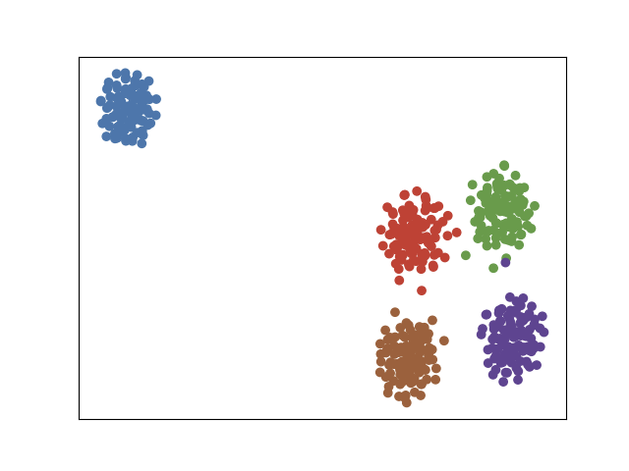
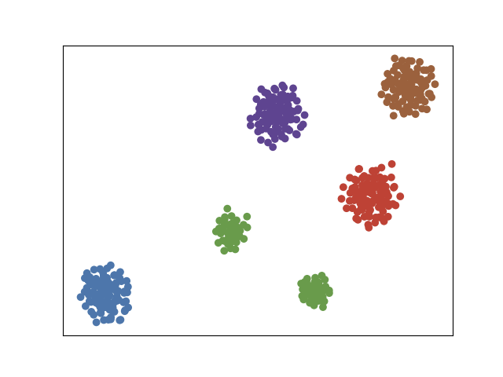
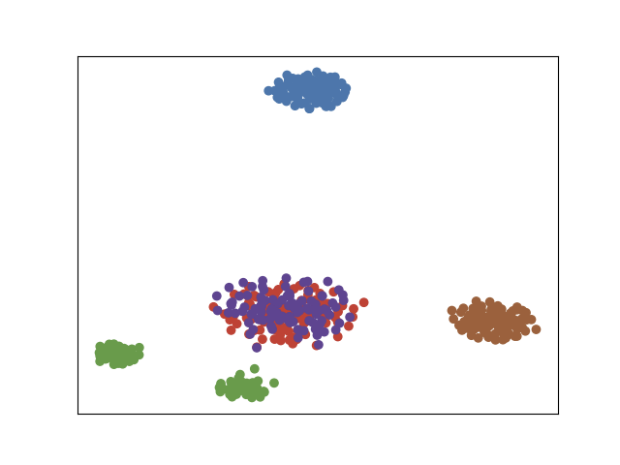
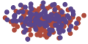
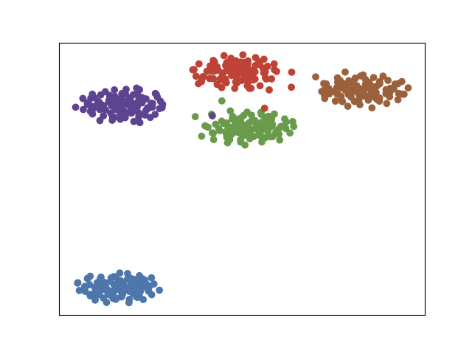
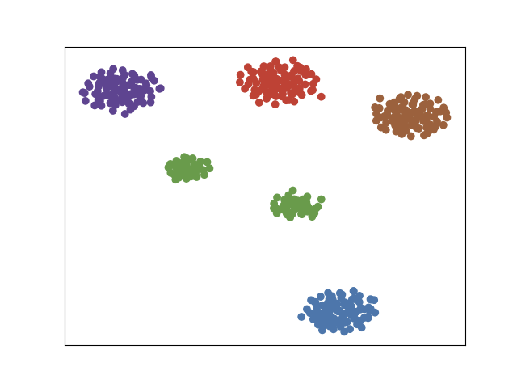
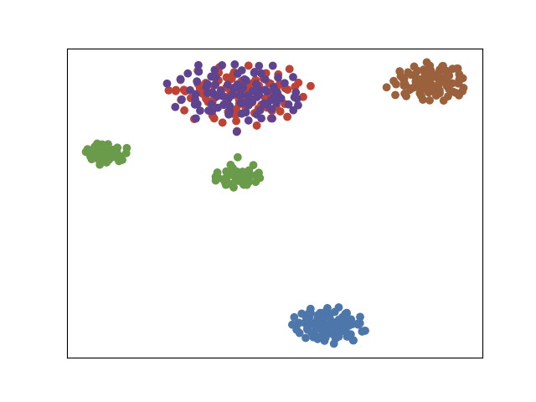
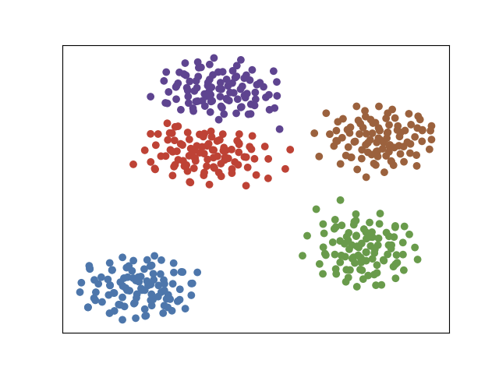
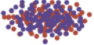
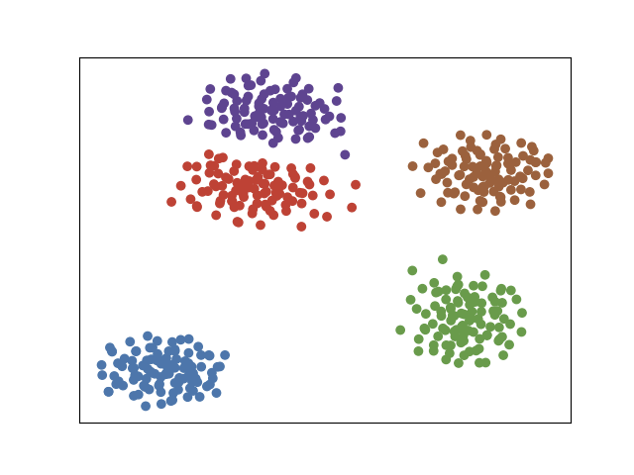
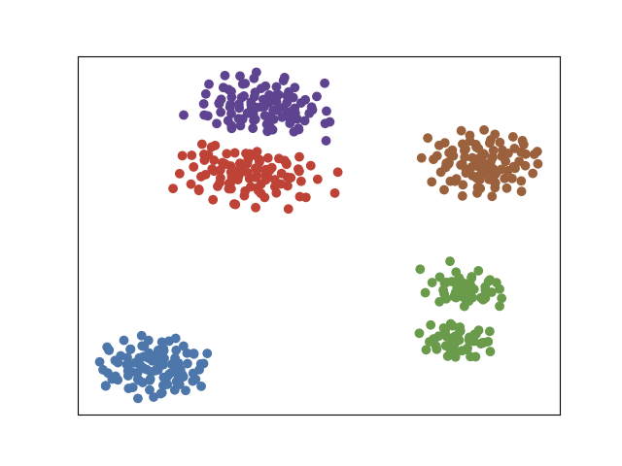
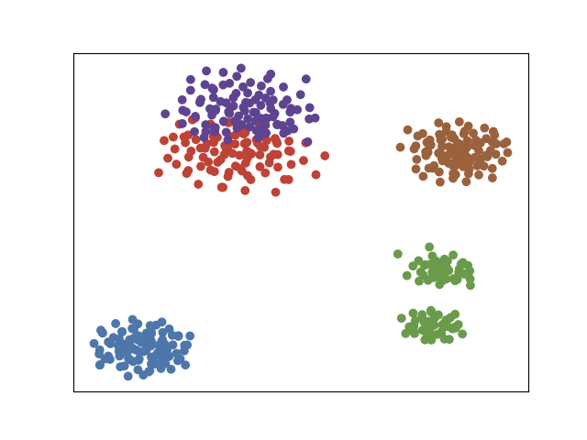
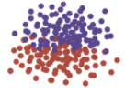
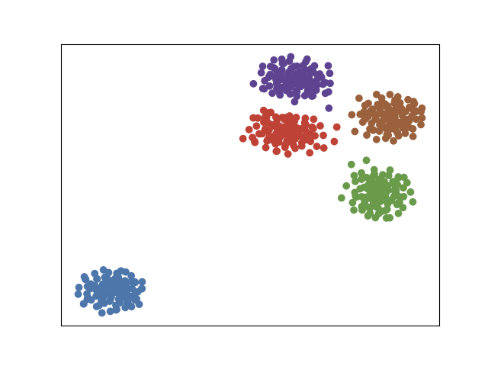
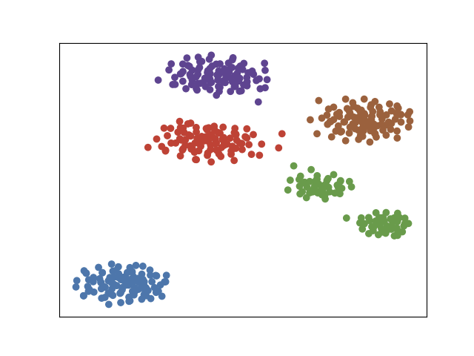
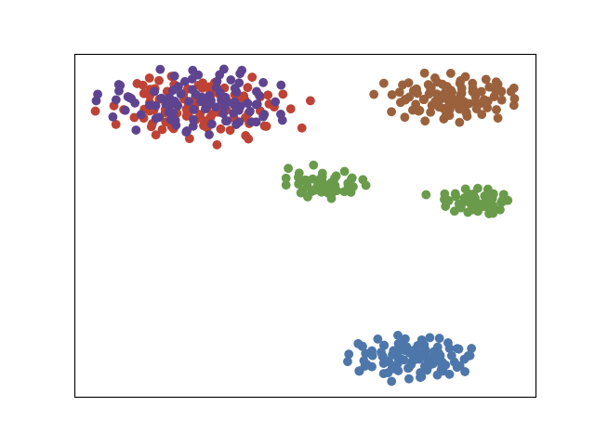
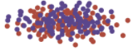
Figure 1
random init tsne
equal init tsne
dynamic tsne
joint tsne
f_0
f_1
f_2
f_3
f_0
f_1
f_2
f_3

Slide 9
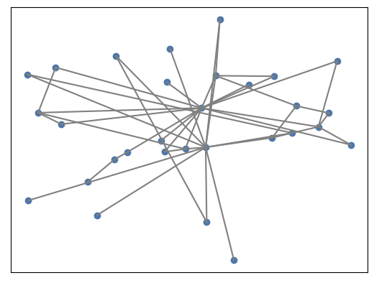
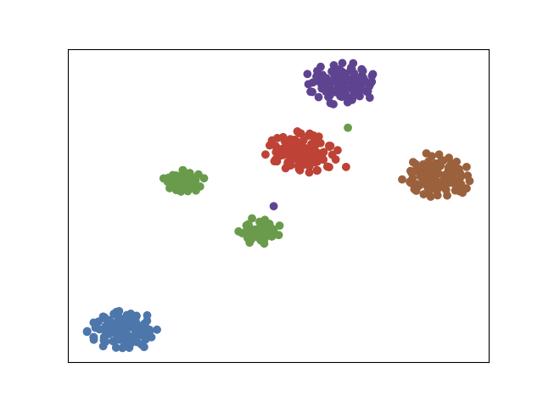
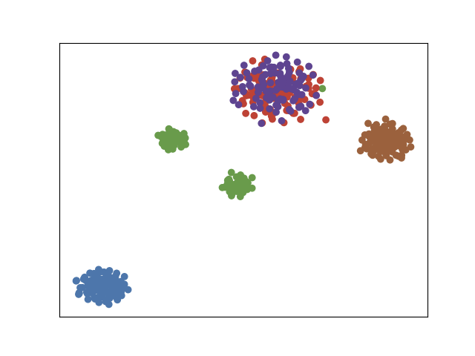
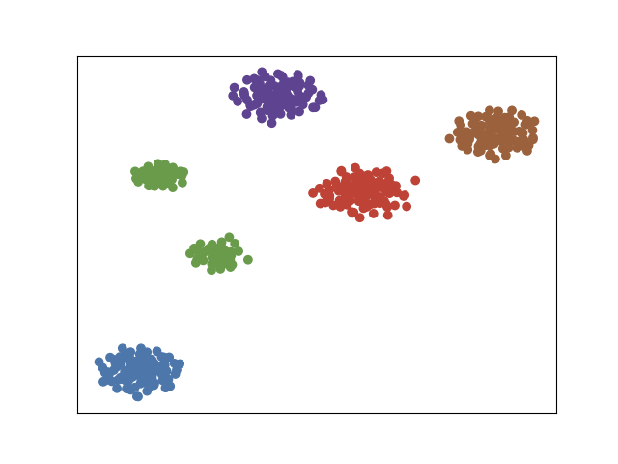
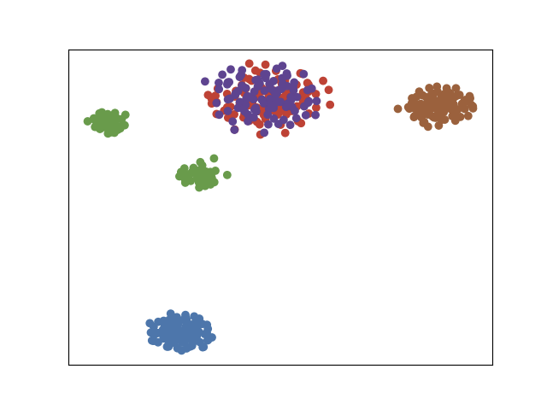
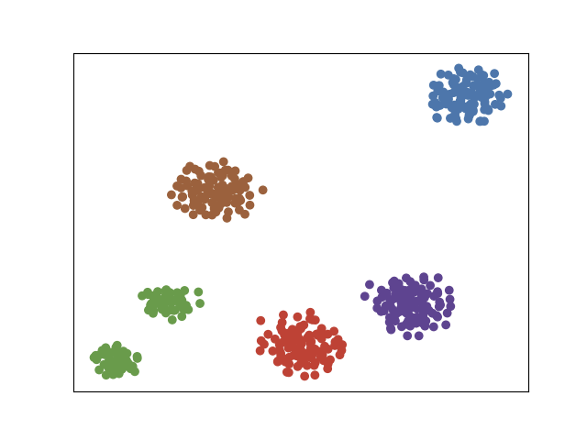
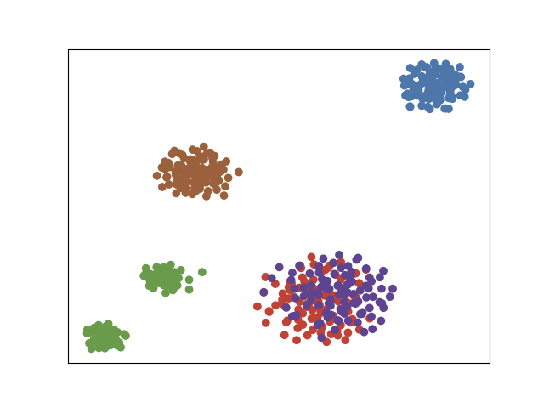
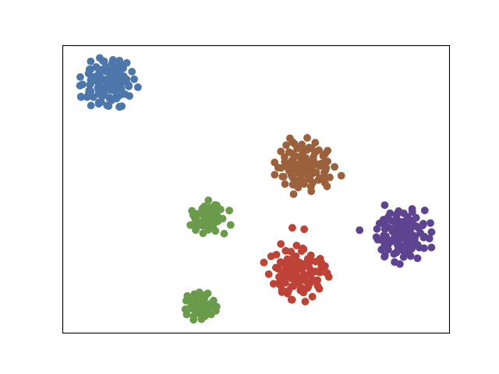
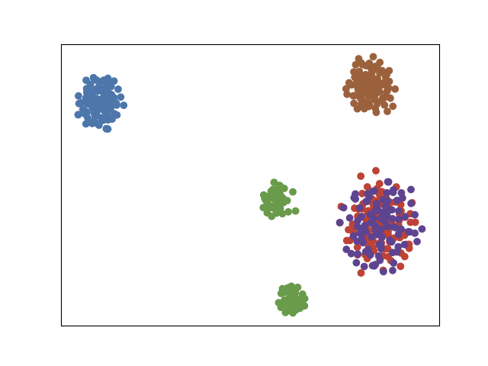
Figure 2
dynamic t-SNE
joint t-SNE
gamma = 0.001
gamma = 0.01
stress error
gamma = 0.1
stress error
f_2
f_3
f_2
f_3
Notes:
尝试更小数量级

Slide 10
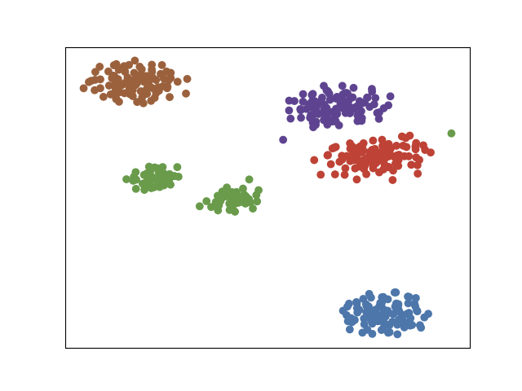
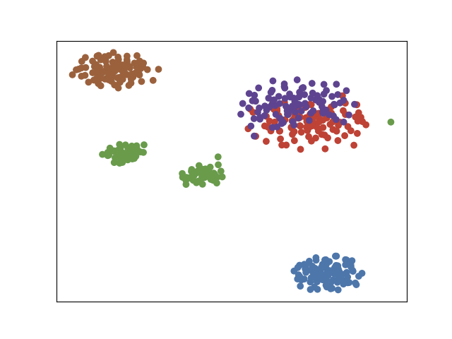
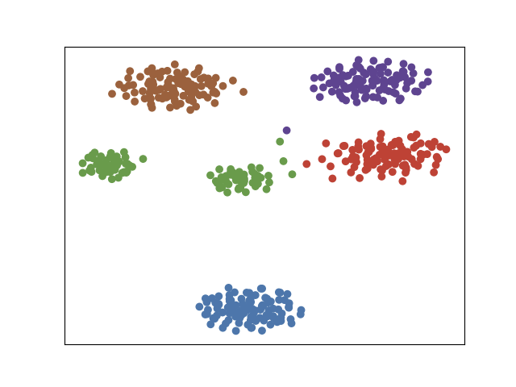
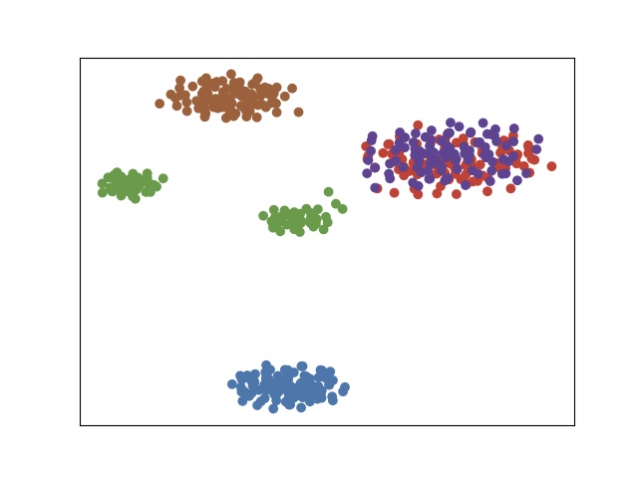
Figure 2
dynamic t-SNE
joint t-SNE
gamma = 0.01
stress error
gamma = 0.05
stress error
gamma = 0.1
stress error
f_2
f_3
f_2
f_3
Notes:
尝试更小数量级

Slide 11
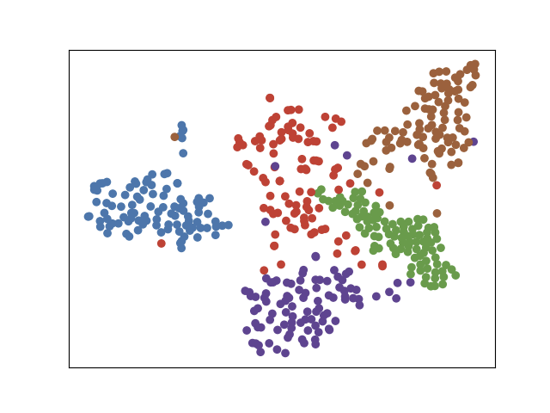
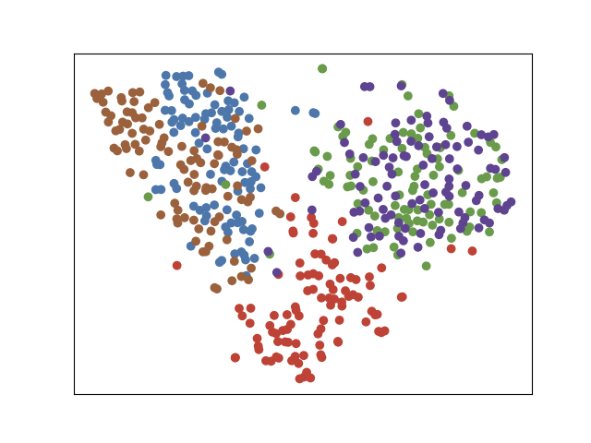
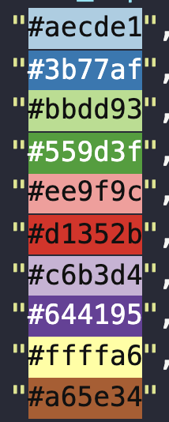
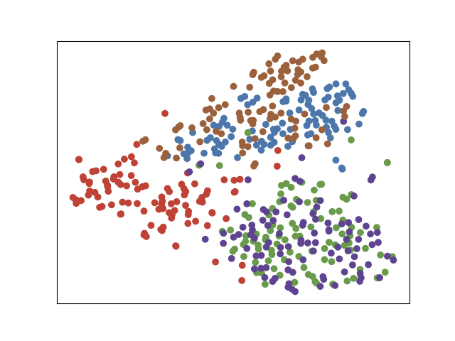
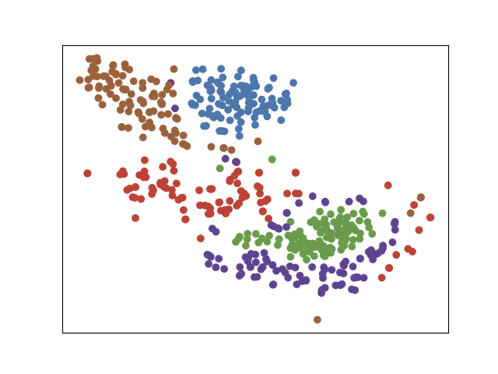
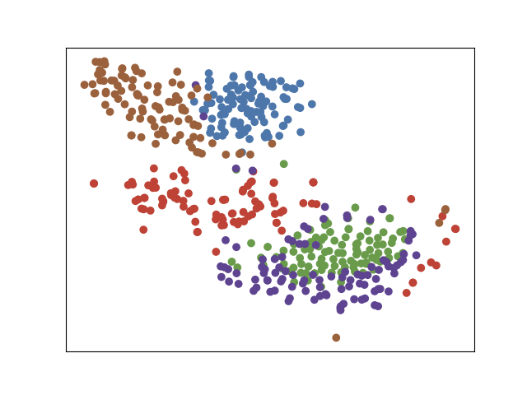
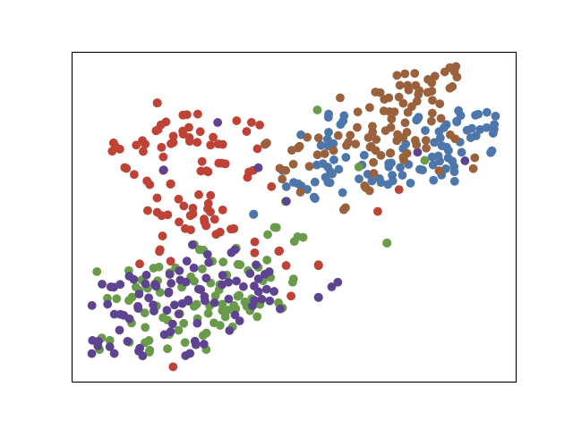
Figure 3
random init tsne
0
9
inconsistent
1
3
2
equal init tsne
3
4
Early distortion
Early distortion
Dataset Description:
f_0: 100 images of number 0~4 from MNIST dataset
f_1: change images of 0 into 9 (which is similar to 4), and 1 into 3
dynamic tsne
Smoothing Effect
joint tsne
f_0
f_1
f_0
f_1
Notes:
每个簇旁放一个数字图片表示
红色簇放大后 用数字图片表示
时间轴纵向

Slide 12
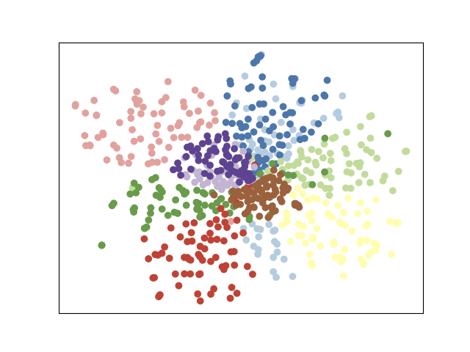
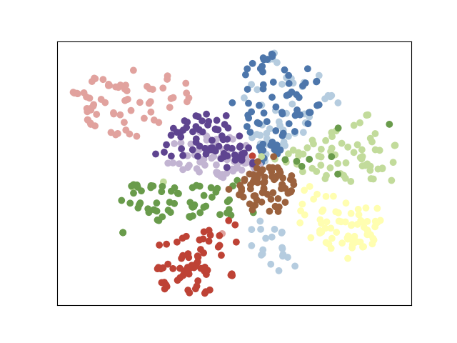
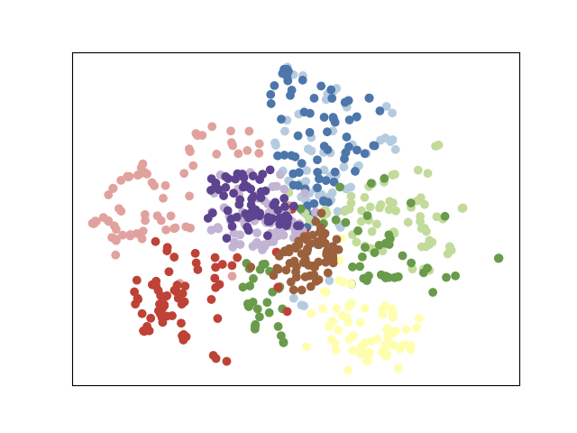
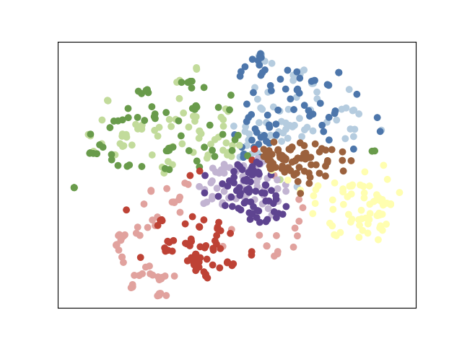
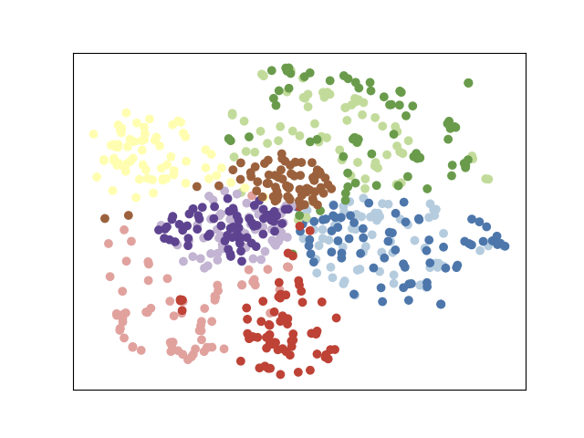
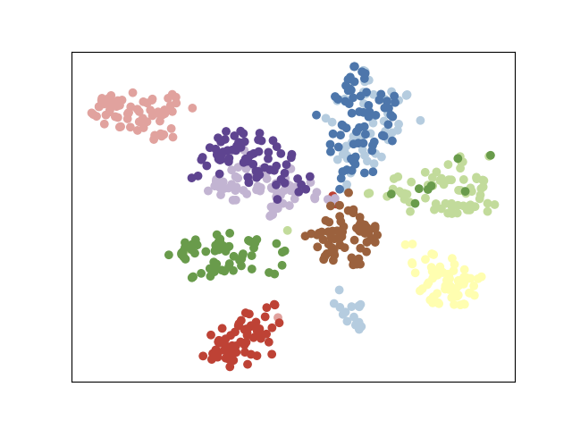
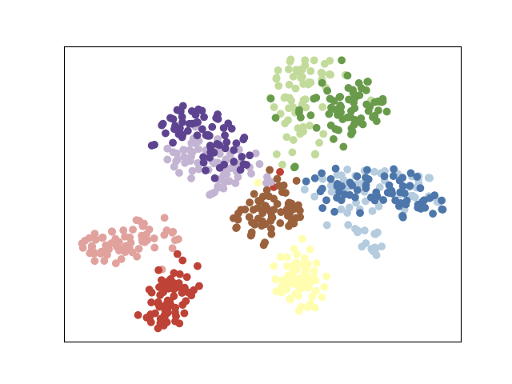
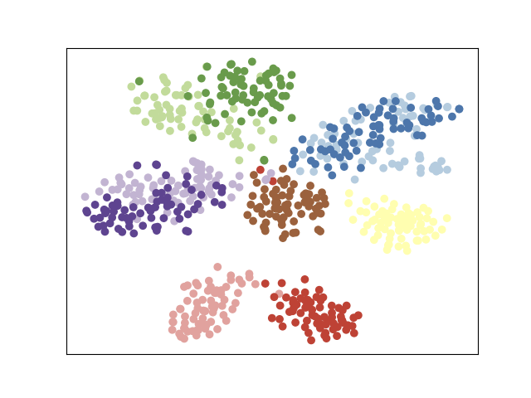
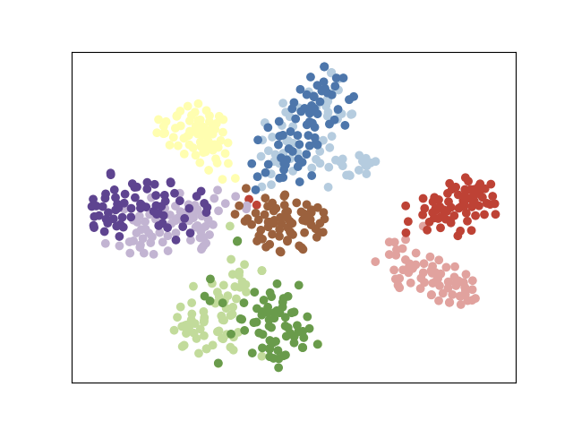
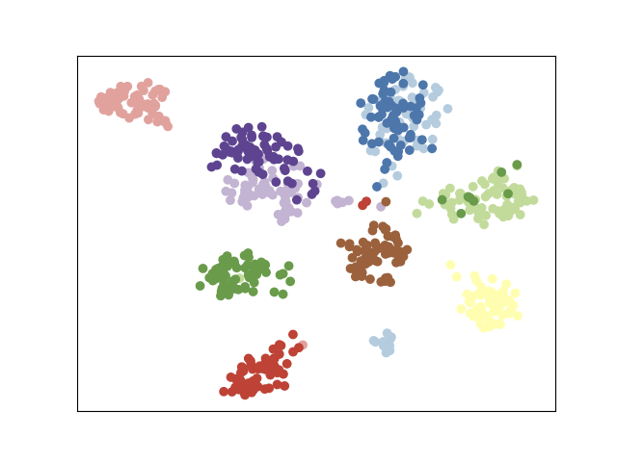
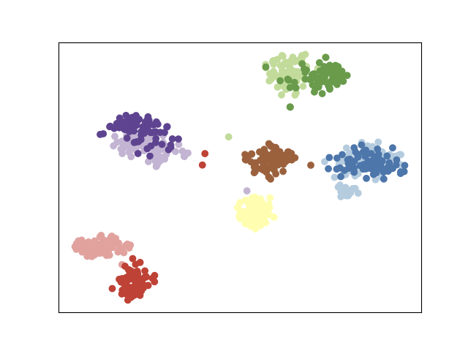
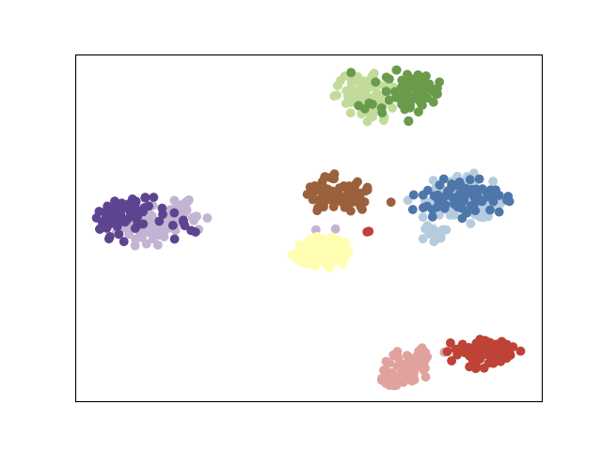
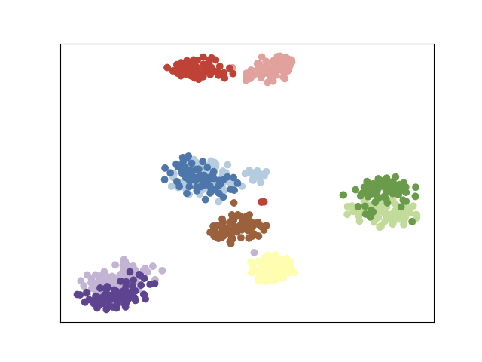
Figure 4
Block5_pool
fc1
More faithful
fc2

Slide 13
Figure 4: to re-run
Block5_pool
fc1
More faithful
fc2

Slide 14

Figure 5
Notes:
节点放大
去掉双向边中的一条
箭头含义

Slide 15
table

Slide 16


Technique
Loss function:

Slide 17


Slide 18

graphlets

Slide 19

random walk
0, graphlets = []
We use random walk to count all graphlets in the graph to achieve a high speed.
But guise only accepts a connected graph. Since our knn graph might not be connected, the codes are as follow:
Guise_on_disconnected_graph(G):
graphlets = []
ccs = get_connected_components(G)
for cc in ccs:
SCount = cc.size() * 1000
graphlets.append(GUISE(cc, SCount))
return graphlets
graphlets.append(gx)
graphlets
Modified from:
M. A. Bhuiyan, M. Rahman, M. Rahman, and M. Al Hasan. Guise: Uniform sampling of graphlets for large graph analysis.
SCount is a hyper parameter for GUISE.
Notes:
SCount is a hyper parameter and here I set it as the nodeNum()*1000 to achieve a balance between speed and accuracy,

Slide 20


We use cosine similarity here.

Slide 21
node_feature(Gs, v):
gfd =[0] * 29;
for g in graphlets_of_node(Gs, v):
type = get_graphlet_type(g);
gfd[type] += 1;
normalize(gfd)
return gfd;

Slide 22

5_cluster_trans_split_overlap_contract
split the cluster using k-means
step 0. translation
step 1. split
step 2. overlap

Slide 23





gamma = 0.01
random init tsne
equal init tsne
dynamic tsne
joint tsne
f_0
f_1
f_2
f_3
Notes:
//Total time for building knn graph: 0.19133448499999983
f_0 from : dynamic tsne

Slide 24



gamma = 0.01

Slide 25





gamma = 0.05
random init tsne
equal init tsne
dynamic tsne
joint tsne
f_0
f_1
f_2
f_3
Notes:
//Total time for building knn graph: 0.19133448499999983
f_0 from : dynamic tsne

Slide 26



gamma = 0.05

Slide 27







gamma = 0.1
random init tsne
equal init tsne
dynamic tsne
joint tsne
f_0
f_1
f_2
f_3
dynamic tsne
joint tsne
f_0
f_1
f_2
f_3
Notes:
//Total time for building knn graph: 0.19133448499999983
f_0 from : dynamic tsne

Slide 28



gamma = 0.1

Slide 29


gamma/ lambda vs. stress error
The stress error is calculated as the average across all time steps and clusters.
Dataset: 10 Clusters
Dataset: our 5 Clusters
When gamma becomes very large, stress error becomes NAN.
Notes:
Therotically it is not a bowl but strictly decrease cuve. However, when the gamma becomes very large: 1 -> 10, the optimization process collapse. the gradient goes in edge constraint direction and makes the

Slide 30

t10k-mnist-replace_0_1
random init tsne
0
9
inconsistent
1
3
2
equal init tsne
3
4
Early distortion
Early distortion
Dataset Description:
f_0: 100 images of number 0~4 from MNIST dataset
f_1: change images of 0 into 9 (which is similar to 4), and 1 into 3
dynamic tsne
Smoothing Effect
joint tsne
f_0
f_1
f_0
f_1
Notes:
Do we use this in case study?

Slide 31
Synthetic data
5_cluster_trans_overlap_contract
translate cluster 0 in frame 0,
overlap cluster 1 and cluster 2 in frame 1,
all clusters contract with 10% in each frame

Slide 32




























f0 - f1
f1 - f2
dynamic tsne
cluster 4
joint tsne
dynamic tsne
cluster 3
joint tsne
"gamma": 0.01,
"dynamic_lambda": 0.01
random init tsne
step 0. translation
step 1. overlap
equal init tsne
dynamic tsne
joint tsne
f_0: dynamic tsne
f_1
f_2
Notes:
5_cluster_trans_overlap_contract.bak3

Slide 33














dynamic tsne
joint tsne
"gamma": 0.02,
"dynamic_lambda": 0.02
random init tsne
step 0. translation
step 1. overlap
equal init tsne
dynamic tsne
joint tsne
f_0: dynamic tsne
f_1
f_2
Notes:
5_cluster_trans_overlap_contract.bak4

Slide 34














dynamic tsne
joint tsne
"gamma": 0.03,
"dynamic_lambda": 0.03
random init tsne
step 0. translation
step 1. overlap
equal init tsne
dynamic tsne
joint tsne
f_0: dynamic tsne
f_1
f_2
Notes:
5_cluster_trans_overlap_contract.bak5
"k_closest_count": 3,
"perplexity": 40,
"bfs_level": 1,
"gfd_calc": "Concatenate",
"beta": 0.0,
"gamma": 0.03,
"anchor_rate": 1.0,
"dynamic_lambda": 0.03

Slide 35














dynamic tsne
joint tsne
"gamma": 0.04,
"dynamic_lambda": 0.04
random init tsne
step 0. translation
step 1. overlap
equal init tsne
dynamic tsne
joint tsne
f_0: dynamic tsne
f_1
f_2
Notes:
5_cluster_trans_overlap_contract.bak6

Slide 36














dynamic tsne
joint tsne
"gamma": 0.05,
"dynamic_lambda": 0.05
random init tsne
step 0. translation
step 1. overlap
equal init tsne
dynamic tsne
joint tsne
f_0: dynamic tsne
f_1
f_2
Notes:
5_cluster_trans_overlap_contract.bak7

Slide 37














dynamic tsne
joint tsne
"gamma": 0.06
"dynamic_lambda": 0.06
random init tsne
step 0. translation
step 1. overlap
equal init tsne
dynamic tsne
joint tsne
f_0: dynamic tsne
f_1
f_2
Notes:
5_cluster_trans_overlap_contract.bak8
good quantitative measure

Slide 38














dynamic tsne
joint tsne
"gamma": 0.07
"dynamic_lambda": 0.07
random init tsne
step 0. translation
step 1. overlap
equal init tsne
dynamic tsne
joint tsne
f_0: dynamic tsne
f_1
f_2
Notes:
5_cluster_trans_overlap_contract.bak9
good quantitative measure

Slide 39














dynamic tsne
joint tsne
"gamma": 0.08
"dynamic_lambda": 0.08
random init tsne
step 0. translation
step 1. overlap
equal init tsne
dynamic tsne
joint tsne
f_0: dynamic tsne
f_1
f_2
Notes:
5_cluster_trans_overlap_contract.bak10

Slide 40














dynamic tsne
joint tsne
"gamma": 0.09
"dynamic_lambda": 0.09
random init tsne
step 0. translation
step 1. overlap
equal init tsne
dynamic tsne
joint tsne
f_0: dynamic tsne
f_1
f_2
Notes:
5_cluster_trans_overlap_contract.bak11

Slide 41
5_cluster_trans_overlap_split_contract
split in k-means

Slide 42







random init tsne
equal init tsne
dynamic tsne
joint tsne
f_0: dynamic tsne
f_1
f_2
f_3
Notes:
Total time for building knn graph: 0.18894512000000008
Computing similairy costs 144.673 s
joint t-sne optimization used: 155.854693278
Dynamic t-sne used: 38.621719352

Slide 43













random init tsne
equal init tsne
dynamic tsne
joint tsne
f_0: dynamic tsne
f_1
f_2
f_3
Notes:
first frame not aligned
Total time for building knn graph: 0.18894512000000008
Computing similairy costs 144.673 s
joint t-sne optimization used: 155.854693278
Dynamic t-sne used: 38.621719352

Slide 44
5_cluster_trans_overlap_split_contract_2
split in random select

Slide 45










random init tsne
equal init tsne
dynamic tsne
joint tsne
f_0: dynamic tsne
f_1
f_2
f_3

Slide 46
5_cluster_trans_overlap_split_contract_3
split in k-means

Slide 47







random init tsne
equal init tsne
dynamic tsne
joint tsne
f_0: dynamic tsne
f_1
f_2
f_3
Notes:
Total time for building knn graph: 0.19044033799999993

Slide 48
Quantitative Analysis
Not finished

Slide 49

Quantitative measures
KL Error
Stress Error
KNN
preservation of microscopic structure
KNC
preservation of meso-scopic structure
BUT doesn’t favour Joint t-SNE
CPD
preservation of macroscropic structure
not used at the moment
Time
The art of using t-SNE for single-cell transcriptomics
Dmitry Kobak & Philipp Berens
Notes:
hardware:
iMac (Retina 5K, 27-inch, 2019)
3.6 GHz 八核Intel Core i9
32 GB 2667 MHz DDR4

Slide 50
data used
* 5_cluster_trans_overlap_contract.bak2
* 6_cluster_dist_trans_overlap
*10_cluster_contract
* vgg 10 class
Parameters: gamma=0.1, dynamic_lambda = 0.1
Notes:
Run different times:

Slide 51














5_cluster_trans_overlap_contract.bak2
random init tsne
step 0. translation
step 1. overlap
equal init tsne
dynamic tsne
joint tsne
f_0: dynamic tsne
f_1
f_2
Notes:
Total time for building knn graph: 0.15964972600000005
Computing similairy costs 89.22 s
joint t-sne optimization used: 115.23504844799999
Dynamic t-sne used: 30.533522604999998
Total time for equal initialization used: 54.866766602999974
Total time for random initialization used: 55.446452491

Slide 52





















f0 - f1
f1 - f2
dynamic tsne
cluster 4
joint tsne
dynamic tsne
cluster 3
joint tsne
dynamic tsne
cluster 0
joint tsne
Notes:
5_cluster_trans_overlap_contract.bak2

Slide 53




quantitative measure
logged
Notes:
as table:
3 tables
10 clusters: 4
5 clusters: 4
mnist:

Slide 54















6_cluster_dist_trans_overlap
random init tsne
equal init tsne
dynamic tsne
joint tsne
f_0: dynamic tsne
f_1
f_2
f_3
Notes:
6_cluster_dist_trans_overlap:
dist_classes = [4]
trans_classes = [1]
overlap_classes = [2, 3]
Total time for building knn graph: 0.283002404
Computing similairy costs 162.245 s
joint t-sne optimization used: 275.215081814
Dynamic t-sne used: 56.224963688
equal init t-sne used: 139.18597485700002
random init t-sne used: 141.78644349899997

Slide 55





quantitative measure
exception

Slide 56
The benefits of joint tsne compared to dynamic tsne
Visually less smoothing effect on 2 synthetic data.
Visually better in high-dimensional data: 1 vgg data.
Better preservation of local structures: smaller stress error on 3 synthetic data.
More faithful: smaller KL and larger KNN almost on all data.
* time cost on all data: too slow, and not comparable because of library
More robust to data: dynamic tsne always cannot find solution in terms of perplexity (implementation problem, nothing wrong in algorithm)
Notes:
We can discuss time burden of each stage of joint tsne.

Slide 57
Real World Use Case

Slide 58
Biology
Dataset from paper “Adult mouse cortical cell taxonomy revealed by single cell transcriptomics.”
Our experiment design:
all together 1600+ cells, 24000+ genes in the original dataset
randomly sample 10000 genes as features for 1600+ cells as dataset 1
use all the other genes as features for 1600+ cells as dataset 2
No alignment of cells in original dataset
The role of different genes vary too much -- cannot use subcomponent (very low similarity)

Slide 59


Biological Datasets
Same RNA-seq measured by different protocols,
Won’t be too many differences ...
The number of points are not the same.

Slide 60

Multifield Scalar Data
Instability simulation of an ionization front dataset: http://sciviscontest-staging.ieeevis.org/2008/data.html
The scientists performed three-dimensional radiation hydrodynamical calculations of ionization front instabilities in which multifrequency radiative transfer is coupled to eight species primordial chemistry.
They simulated ten scalar fields: particle density, temperature, and 8 chemical species. The velocity field is also simulated.

Slide 61





GSE71585_RefSeq_RPKM
equal init tsne
random init tsne
joint tsne
Notes:
Total time for building knn graph: 86.429982076
Computing similairy costs 255.673 s
joint t-sne optimization used: 880.2179808809999
equal init t-sne used: 1248.9006134289998
random init t-sne used: 1317.085674992
dynamic tsne cannot run, therefore discard

Slide 62





GSE71585_RefSeq_RPKM_dim_1000
equal init tsne
random init tsne
joint tsne
Notes:
1000 from first 10000,
1000 from second 14000
Total time for building knn graph: 8.827578746
Computing similairy costs 1221.07 s
dynamic tsne is discarded

Slide 63




GSE71585_RefSeq_RPKM_dim_1000_2
"k_closest_count": 3,
"perplexity": 20,
"bfs_level": 1,
"gfd_calc": "Concatenate",
"beta": 0.0,
"gamma": 0.1,
"anchor_rate": 1.0,
"dynamic_lambda": 0.1
equal init tsne
random init tsne
joint tsne
Notes:
first 2000 dims
Total time for building knn graph: 10.744129013
Computing similairy costs 1056.46 s
dynamic tsne collpase

Slide 64
2. MNIST: Subcomponent(Top Half) VS Whole Image
f_0
f_1

Slide 65







mnist1000
random init tsne
equal init tsne
dynamic tsne
joint tsne
f_0: dynamic tsne
f_1
Notes:
from https://lvdmaaten.github.io/tsne/
Total time for building knn graph: 1.2687556789999999
Computing similairy costs 47.351 s
Dynamic t-sne used: 116.871555422

Slide 66












mnist2500
random init tsne
equal init tsne
dynamic tsne
f_0: dynamic tsne
joint tsne
f_1
f_0
f_1
dynamic tsne as f_0
seperate f_0
Notes:
from https://lvdmaaten.github.io/tsne/

Slide 67












digit_mnist_1000
random init tsne
equal init tsne
dynamic tsne
f_0: dynamic tsne
joint tsne
f_1
f_0
f_1
dynamic tsne as f_0
seperate f_0
Notes:
Total time for building knn graph: 1.2687556789999999
Computing similairy costs 47.351 s

Slide 68
3. MNIST: Original Image VS Image after Horizontal Flip
f_0
f_1

Slide 69













digit_mnist_flip_1000
random init tsne
equal init tsne
dynamic tsne
f_0: dynamic tsne
joint tsne
f_1
f_0
f_1
dynamic tsne as f_0
seperate f_0
Notes:
Total time for building knn graph: 2.077885084
Computing similairy costs 42.504 s

Slide 70
4. MNIST: Original Image VS Image after Horizontal Flip
Flip only half of the odd numbers
f_0
f_1

Slide 71





t10k-mnist: 9 -> 0
dynamic tsne
joint tsne
f_0
f_1
f_0
f_1
Notes:
实在不行再改gamma

